Slide 1
Environment Setup and Developing Your First Agent
Prepared by: Muhammad Abdul Qayum
National Textile University, Faisalabad
Ref: Ch#3, Building Agents with Open AI Agents SDK by Henry Habib
Notes:
https://projector.tensorflow.org/

Slide 2
What You Will Learn in This Chapter
Environment Setup
Install Python & create virtual environment
Install openai-agents SDK
Configure API key securely & run test script
Development Prerequisites
Python essentials: type hints, docstrings, decorators
Async programming (async/await)
Using Pydantic for structured data validation
Build Your First AI Agent
Create a customer service agent
Add tools (e.g., order status lookup)
Implement handoff to a specialized retention agent
Apply full agent control-logic workflow

Slide 3
Environment setup
Download and install python
Install uv by following commands
https://www.notion.so/UV-Installation-236e9749823180b7ab82d96a3b5997fd

Slide 4
What is uv?
uv is a fast,
all-in-one tool for managing Python projects end-to-end. I
t can create a virtual environment,
download and pin a specific Python version,
add or update dependencies,
maintain a lock file for reproducible installs,
run code and tools without manual activation,
and build/publish packages. You mainly work with two files:

Slide 5
UV installation
Step 1: Open PowerShell as Admin
Step 2: Run Installation Script
powershell -ExecutionPolicy ByPass -c "irm https://astral.sh/uv/install.ps1 | iex"
Or
Pip install uv
Step 3: Verify
uv --version
Notes:
Step Title Description
1 Initialize the Project uv init scaffolds a clean project structure and starter pyproject.toml, replacing manual folder setup and template copying.
2 Pin the Python Version uv python pin 3.12 ensures everyone uses the same interpreter version, downloading it if necessary and recording it for all devs and CI.
3 Create Environment uv creates a virtual environment automatically on first dependency action. uv run lets you execute code without manual activation.
4 Add Runtime Dependencies uv add pkg updates your manifest, resolves, locks, and installs in one atomic step—keeping declared and installed packages in sync.
5 Add Dev Tools uv add --dev tool cleanly separates dev dependencies (tests, lint, format) from runtime packages, all in the same lock file.
6 Optional Feature Groups uv add --group docs mkdocs lets you define install-on-demand groups for optional features.
7 Lock Dependencies uv automatically maintains uv.lock after changes for reproducible installs.
8 Sync Environment uv sync ensures the environment matches the lock file exactly; uv sync --frozen blocks changes unless the lock is updated.
9 Run Code & Tools uv run <cmd> runs commands in the correct environment without needing to activate the venv.
10 Lint / Format / Type Check Running tools via uv run ensures they use the exact locked versions locally and in CI.
11 Test uv run pytest guarantees tests run with the locked dependency set—no “works on my machine” surprises.
12 Upgrade Dependencies uv upgrade re-resolves, locks, and installs updates in one controlled step.
13 Build Artifacts uv build quickly produces both wheel and sdist artifacts with minimal config.
14 Publish uv publish builds (if needed) and uploads to PyPI or another index in one step.
15 Use Cache Shared caching speeds up installs and can be inspected or pruned.
16 Offline / Restricted Cache export/import plus uv sync --frozen allows full offline environment recreation.
17 CI Reproducibility uv sync --frozen in CI ensures lock and manifest match before install.
18 Inspect Environment uv run pip list and similar commands always target the project’s environment, not the global Python.
19 Clean & Prune uv cache prune or environment removal frees space; everything can be rebuilt from manifest + lock.
20 Monorepo Management Each project in a monorepo can have its own pyproject.toml + uv.lock for independent syncing.
21 Migrate (Optional) uv can import specs from legacy requirement files, resolve, and lock—simplifying to the two-file model.

Slide 6
Install the latest PowerShell for new features and improvements! https://aka.ms/PSWindows PS C:\WINDOWS\system32> powershell -ExecutionPolicy ByPass -c "irm https://astral.sh/uv/install.ps1 | iex" Downloading uv 0.9.11 (x86_64-pc-windows-msvc) Installing to C:\Users\qayum\.local\bin
uv.exe
uvx.exe
uvw.exe
everything's installed!
To add C:\Users\qayum\.local\bin to your PATH, either restart your shell or run:
set Path=C:\Users\qayum\.local\bin;%Path% (cmd)
$env:Path = "C:\Users\qayum\.local\bin;$env:Path" (powershell)
PS C:\WINDOWS\system32>

Slide 7
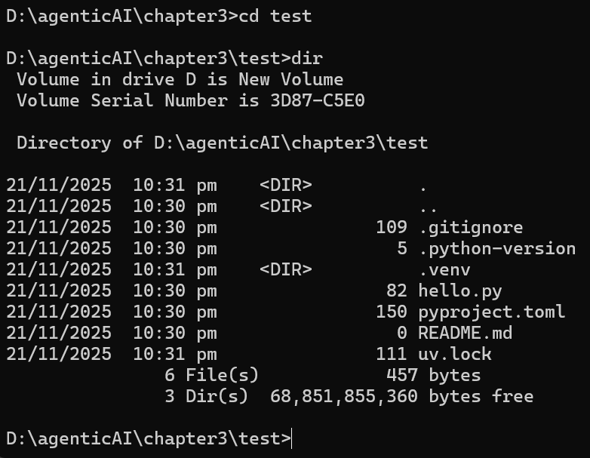
Creating Test application
D:\> mkdir agenticAi
Cd agenticAi
D:\agenticAI>mkdir chapter3
Cd chapter3
D:\agenticAI\chapter3> uv init test
It will create the directory test
Cd test
In test directory you will see complete environment
Notes:
Environment automatically created when we run the python first time or we can do It by following commands
Create the Environment
Create the virtual environment and lock file immediately (handy for editor setup like VS Code):
uv sync
Uv init --package project create src folder

Slide 8
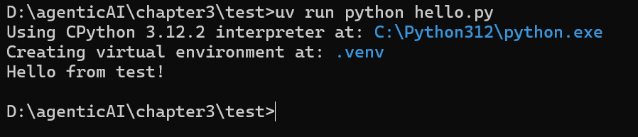
Executing the hello.py
It will create .venv environment

Slide 9
Adding openai agent SDK in UV
uv add openai-agents

Slide 10
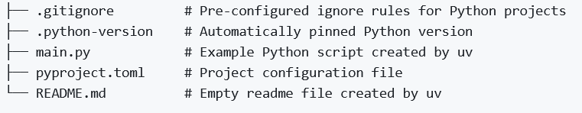
Notes:
# Create & enter project
uv init --package my-packaged-app
cd my-packaged-app
# Env & lock
uv sync
# Run (script entries)
uv run my-packaged-app
uv run my-packaged-app-main
# Run (module and file)
uv run -m my_packaged_app.main
uv run python ./src/my_packaged_app/main.py # (Windows: .\src\my_packaged_app\main.py)
# Dependencies & dev tools
uv add <package-name> # runtime
uv add --dev ruff black mypy # dev tools (example)
# Reproduce exact env
uv sync --frozen

Slide 11
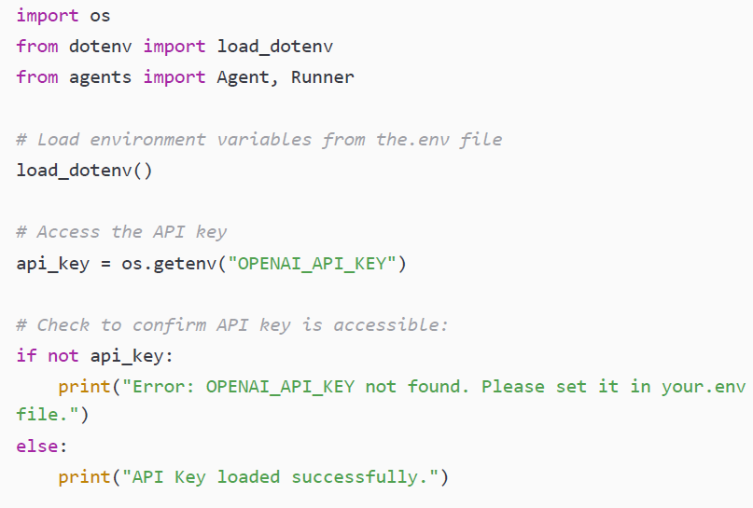
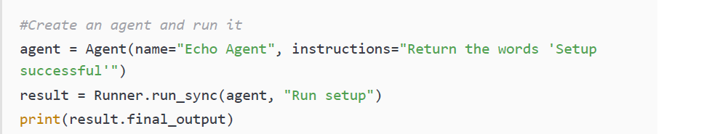
Verifying the environment setup
This module provides a way to interact with the underlying operating system

Slide 12
Updated with gemeni 1/2
import os
from dotenv import load_dotenv, find_dotenv
from agents import Agent, Runner, OpenAIChatCompletionsModel, AsyncOpenAI
# Load environment variables from the.env file #load_dotenv()
load_dotenv(find_dotenv())
#Which LLM Provider to use? -> Google Chat Completions API Service
external_client: AsyncOpenAI = Syncopial(
api_key=os.getenv("GEMINI_API_KEY"),
base_url="https://generativelanguage.googleapis.com/v1beta/openai/",
)

Slide 13
Updated with gemeni 2/2
2. Which LLM Model to use?
llm_model: OpenAIChatCompletionsModel = OpenAIChatCompletionsModel(
model="gemini-2.5-flash",
openai_client=external_client
)
# Check to confirm API key is accessible:
if not os.getenv("GEMINI_API_KEY"):
print("Error: GEMINI_API_KEY not found. Please set it in your.env file.")
else:
print("API Key loaded successfully.")
#Create an agent and run it
agent = Agent(name="Echo Agent", instructions="Return the words 'Setup very successfully’”, model=llm_model )
result = Runner.run_sync(agent, "Run setup")
print(result.final_output)

Slide 14
Development prerequisites
More than Installation Required You need familiarity with certain Python design patterns—not just environment setup—to use the SDK effectively. (Think: knowing how to drive and having a car!)
SDK is Built on Pythonic Architecture The framework relies on specific constructs such as decorators, type hints, and structured functions—knowing them makes development smoother.
Not a Python Tutorial This section doesn’t teach Python basics; it only covers what's needed to understand SDK examples.
Focus on Three Key Principles A short primer is provided on essential Python features required throughout the book.

Slide 15
Python functions architecture
Agents SDK Works Through Python Code
You interact with the SDK by writing Python code
Your code extends what an agent can do
Tools Are Just Python Functions
The SDK allows you to define “tools”
A tool is simply a Python function the agent can call
Example: a function to search emails, calculate totals, or fetch weather
Python Skills Needed
Understand how to create functions
Know how to pass arguments and return values
Think of it as teaching AI to use your function just like you do

Slide 16
Python Concepts Used in OpenAI Agents SDK
Type Hints
Define expected input and output types in functions
SDK reads type hints to understand tool parameters
Helps LLM know what arguments your tool needs
Example: input = integer, output = string —
Docstrings
Written immediately under a function definition
Explain what the function does, its inputs, and outputs
Helps the LLM interpret tool behavior
Not required, but improves understandability
Decorators
Wrap a function to modify or enhance behavior
Used to mark functions as tools (e.g., @function_tool)
Allow adding metadata like name, description, and schema
Like adding a badge that says “Hey AI — this function is important!”

Slide 17
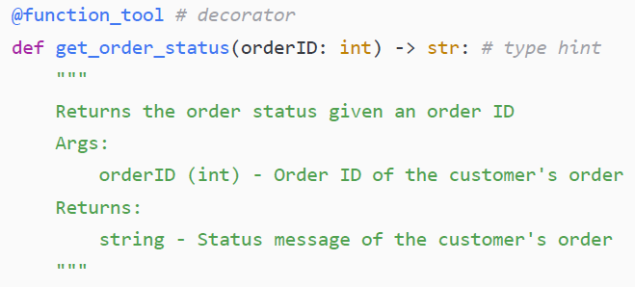
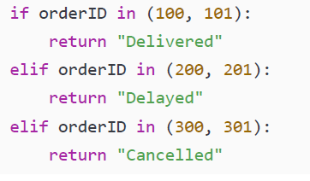
Example
Notes:
@function_tool # decorator
def get_order_status(orderID: int) -> str: # type hint
"""
Returns the order status given an order ID
Args:
orderID (int) - Order ID of the customer's order
Returns:
string - Status message of the customer's order
""“
if orderID in (100, 101):
return "Delivered"
elif orderID in (200, 201):
return "Delayed"
elif orderID in (300, 301):
return "Cancelled"

Slide 18
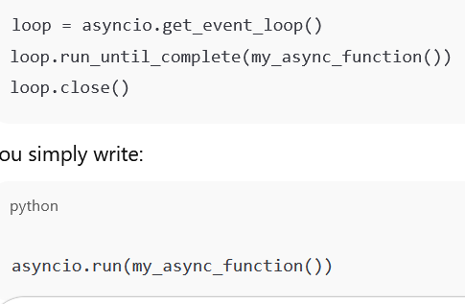
Python asynchronous programming
The basics of Python’s asynchronous programming can be summarized as follows:
An async function is defined using async def instead of the traditional def statement
async functions must be called by prepending the execution with await
async functions can only be called by other async functions or an event loop
An event loop can be created in Python using the asyncio.run() command(It creates an event loop, Runs your async function until it finishes Cleans up the loop afterward)
Notes:
Most modern Python programs are synchronous, meaning that each step in the program executes one at a time sequentially. In short, each step must be successfully completed before the next one can begin. This contrasts with asynchronous programming, which handles operations concurrently and which (thankfully) Python also supports with the asyncio library and async/await commands.
OpenAI Agents SDK provides both synchronous and asynchronous ways to run agents. However, the preferred way to run the agent is asynchronously, especially for more complex use cases (e.g., running multiple agents or tools in parallel). Agentic workflows are asynchronous, spending much of their time waiting for external operations such as API calls, tool executions, LLM responses, and so on. To manage this efficiently and enable your agent to do multiple things at the same time, OpenAI Agents SDK uses Python’s asynchronous programming features without blocking the whole program.

Slide 19
Python Pydantic data validation
Pydantic is a comprehensive Python library used for data validation.
In short, this library enables developers to define a data structure (called a model),
and the library will automatically verify that a specific data input matches that data structure.

Slide 20
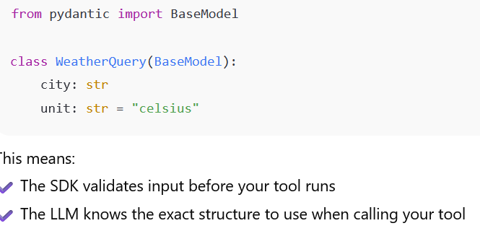
Python Pydantic data validation
1. Structured Tool Inputs
When you build tools, you don't just rely on plain type hints—you can define Pydantic models.

Slide 21
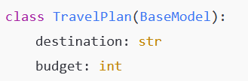
Python Pydantic data validation
2. Structured Agent Outputs
Agents don’t just return text — you can force them to output a data model.
Now the agent must output something matching this form

Slide 22
Python Pydantic data validation
3. Guardrails During Execution
Agents sometimes misbehave — like students skipping steps. Pydantic guardrails act like checkpoints:
Validate the data
Block bad values
Trigger rules like:
InputGuardrailTripwireTriggered This means “ you sent bad data, fix it before moving on!”
It catches problems mid-execution, not after failure.
Example use cases:
Check budget must be positive
Ensure email formatting is correct
Validate sensor data before continuing a workflow

Slide 23
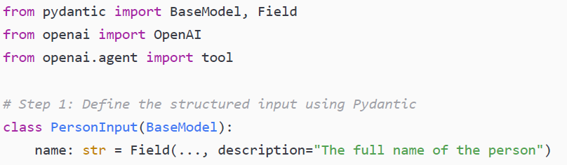
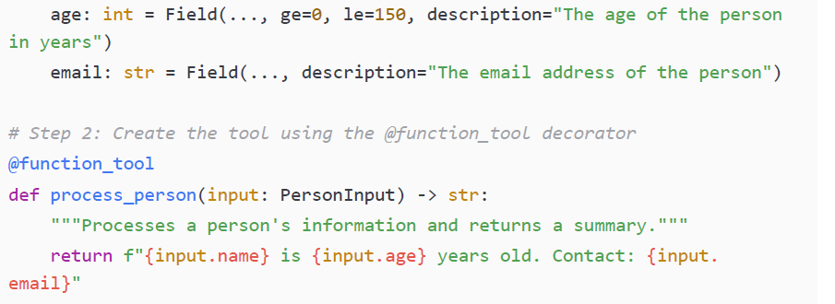
Python Pydantic data validation
Field → used to describe properties and metadata for model fields
Notes:
class PersonInput(BaseModel):
name: str = Field(..., description="The full name of the person")
✔ BaseModel → defines a data structure
✔ Field() → adds rules and description

Slide 24
Developing your first AI Agent

Slide 25
A simple customer service agent
Suppose we are building a customer service agent, one that can be used by our company to facilitate customer requests.
Create a new Python file under the Chapter3 folder called customer_service_agent.py, and write the code needed to define the agent, provide input, and then run the agent.

Slide 26
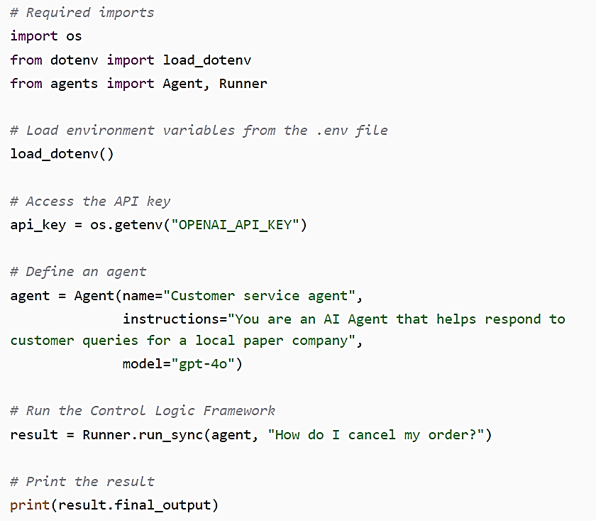
A simple customer service agent
To cancel your order, please contact our customer service team directly. You can reach us by phone at [Your Phone Number] or email us at [Your Email Address]. Be sure to have your order number handy so we can assist you quickly.

Slide 27
A simple customer service agent
This section explains how an agent is built and executed using the OpenAI Agents SDK:
Required libraries and environment variables are imported to prepare the runtime environment.
An Agent object is created with attributes such as name, instructions, and model, which act as the agent’s system prompt and define its behavior—in this example, as a customer support assistant.
The agent is executed using Runner.run_sync, which sends the user input to the model and runs the agent lifecycle, leveraging the SDK’s control logic to invoke the LLM and process responses.

Slide 28
Adding a tool
Adding a Delivery Status Tool
We introduce a tool to check order status based on order ID
Simplified logic is used (hardcoded results instead of a real database)
Why This Matters
The key idea is not the implementation complexity…It is how the SDK handles tool usage automatically.
What the SDK Handles for Us
✔ Determines whether the tool is needed ✔ Creates or formats tool inputs ✔ Runs the tool function ✔ Reads and incorporates tool output into its reply
Benefit
The developer just defines the function —the agent learns to think, decide, and act with it.

Slide 29
We introduce a tool to check order status based on order ID Simplified logic is used (hardcoded results instead of a real database)
The key idea is not the implementation complexity… It is how the SDK handles tool usage automatically.
The developer just defines the function — the agent learns to think, decide, and act with it.

Slide 30
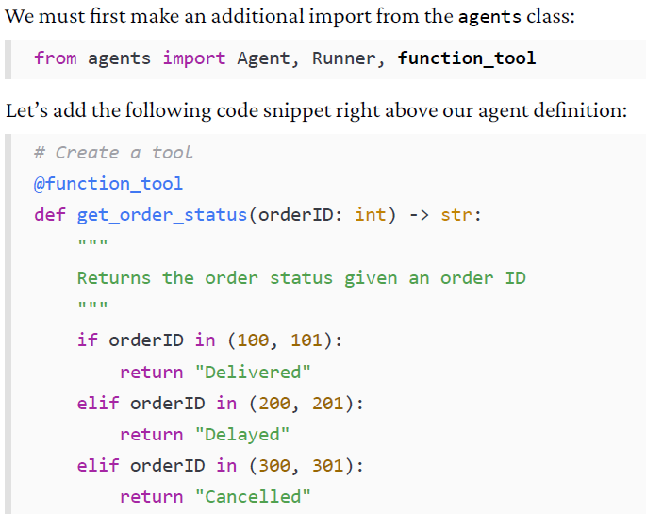
Adding a tool

Slide 31
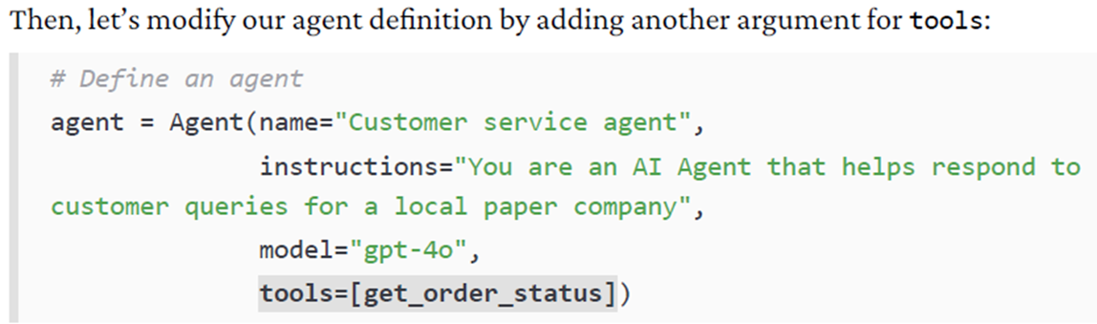
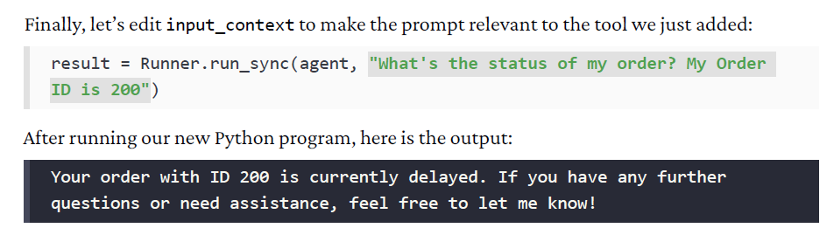
Adding a tool
Notes:
In this example, we added a tool called get_order_status to our customer service agent. We needed to do two things to add the tool to the agent:
We added a @function_tool decorator to the custom Python function. This decorator informs the SDK of the tool’s name, its arguments, its purpose, and its return type, all done via the function’s type hints and docstrings. This is important: any Python function can become a tool that is called by the agent once it’s decorated with the @function_tool class.
We added the name of the function to a list, which we then passed in the tools argument when we instantiated the agent object.
After doing this, the agent can decide to use the tool based on its overall objectives and the input task it has been given. In our case, the user asked explicitly about the status of an order and provided an order ID.

Slide 32
trace.
Go to https://platform.openai.com/ and log in with the same account you logged in with previously (where you had generated the API key).
Select Dashboard from the top-right menu and then select Traces from the left menu.
Select the trace with the most recent Created time. You should see a trace that looks like the following:

Slide 34
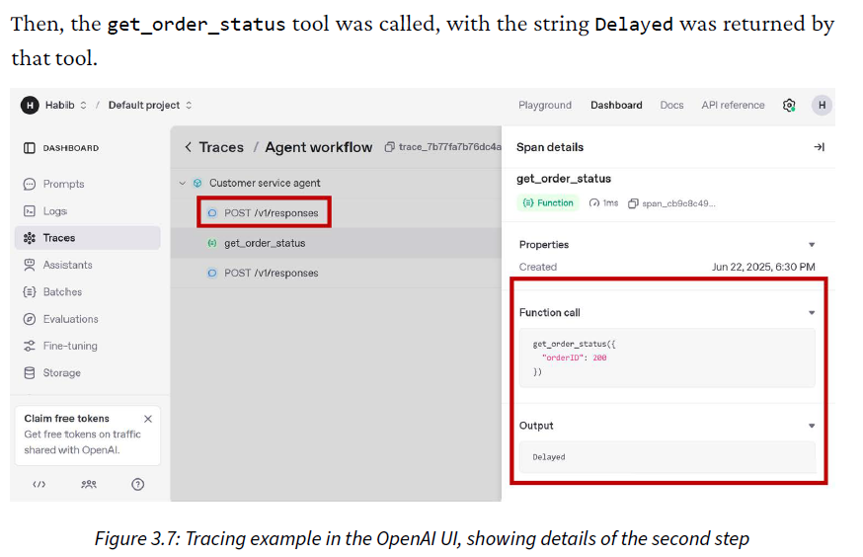
Notes:
This trace tells you everything you need to know about your agent run, and you can click each individual step within a trace to get more details. In my case, I see that the Runner class first called the LLM with the system prompt and input prompt we had described before. The result of that LLM call was to execute a function call, with "orderID": 200 as the input argument.

Slide 35
Note
It is worth knowing that just because a tool is accessible to the agent does not mean that the agent will use it.
In fact, this is one of the most important aspects of agentic AI: tool choice and
other decisions are not deterministic. Instead,
decision-making is made based on the context of the user’s request. If the user instead asked How do I change my password?, then it would not need to call the get_order_status tool.

Slide 36
Adding a handoff
Agent Handoff Concept
OpenAI Agents SDK supports handing tasks from one agent to another
Enables multi-agent workflows and specialization
Why Handoffs Matter
✔ Breaks complex problems into sub-tasks ✔ Allows agents to specialize in specific domains ✔ Improves decision quality and modularity

Slide 37
Adding a handoff
Example Scenario
A customer asks to cancel an order
The main support agent transfers the case
A specialized retention agent takes over
It may provide offers
Apply discount strategies
Try to convince the customer to stay

Slide 38
Adding a handoff
Benefits of Agent Handoffs
✔ Cleaner responsibility separation ✔ Better performance through expertise ✔ Scales to multi-agent systems

Slide 39
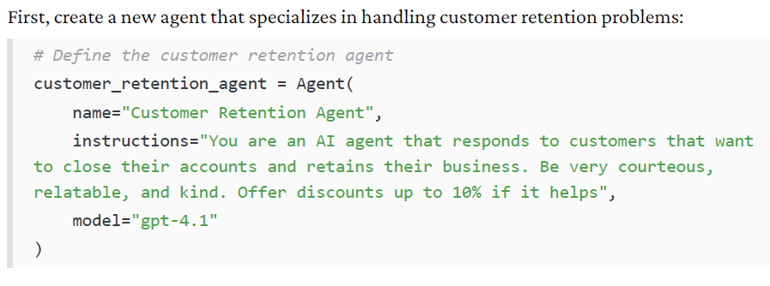
Example

Slide 40
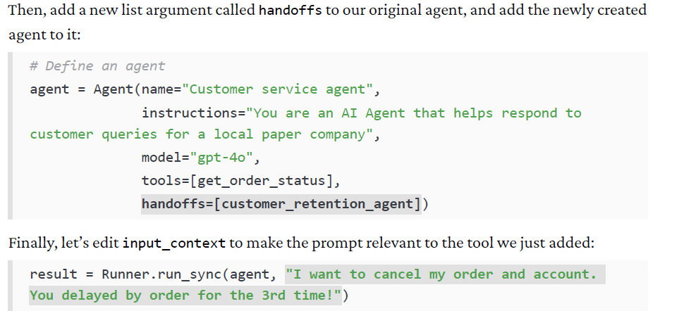

Slide 41
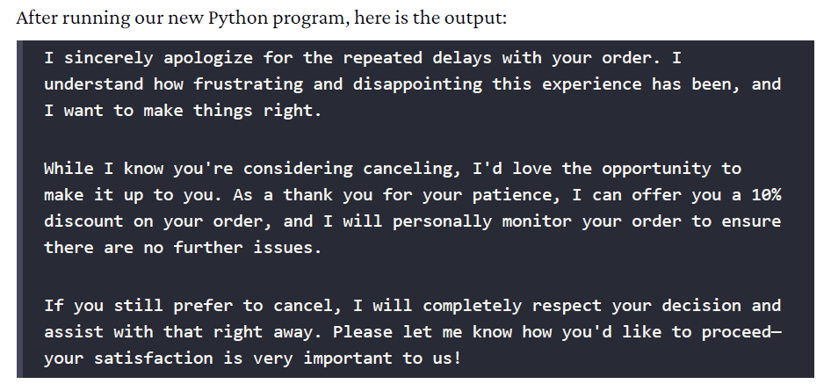
Notes:
This multi-agent setup can be expanded to many agents and complex routing logic. The power here is that each agent can have its own persona and capabilities, and you let the model decide which agent is appropriate via the handoff mechanism. The SDK’s role is to seamlessly pass control (including conversation history if any) from one agent to another as directed by the model’s output.

Slide 42
Notes:
In this case, we have created two agents: the agent that we had before that acts as a customer service manager, and another called customer_retention_agent that specializes in customer retention. The customer service manager agent fields any requests from the customer, and then either responds to the inquiry, calls the get_order_status tool, or hands off the task to the customer retention agent.
In this example, during the control logic framework loop, the LLM again did not return a final_output. Instead, it decided to hand off the task and input context to another agent. The Runner class in the SDK sees that and switches context to the other agent (with the same user question). Then, that agent is now “in charge,” processes the user request, and produces the final answer.

Slide 43
summary
Chapter Overview
Environment setup for OpenAI Agents SDK
First agent creation and feature enhancement
Environment Setup
✔ Installed SDK inside virtual environment ✔ Configured API key ✔ Verified with a minimal agent run
Python Concepts Required
Type hints & docstrings → help LLM understand tool inputs
Decorators → mark functions as tools
Async execution → supports concurrent agent operations
Pydantic models → validate structured inputs & outputs

Slide 44
First Agent Built
Created a customer service assistant
Defined instructions and behavior logic
Adding Tooling
Built a function: get_order_status
Applied @function_tool decorator
Agent now decides when to call the tool
Multi-Agent Orchestration
Created second agent specialized in retention
Enabled task delegation through agent handoff
What the SDK Does Behind the Scenes
✔ Manages reasoning ✔ Chooses tools ✔ Executes tools ✔ Switches agents when needed

